Slide 1

The Hidden Concept – A Puzzle-Based Teaching Adventure
An Escape-Room Inspired Approach to Active Learning
Salma ElSayed
Lecturer, Abertay University
Dundee, Scotland
s.elsayed@abertay.ac.uk
Notes:
Escape the Slide Deck! Puzzle-Based Learning for Active Engagement
Good morning to you all. Welcome and thank you for joining me on this interactive ride! Today, we’re going to explore how puzzles can unlock deeper engagement and critical thinking in our classrooms.
You will try to find a hidden phrase to "escape" just like students in one of my modules.

Slide 2

Who’s been to an escape room?
What theme?
What do you like about it?
Learned any new facts?
Notes:
Who’s been to an escape room recently? Or ever?
You can pop your answer in the chat.
Did you learn new information? Facts?

Slide 3
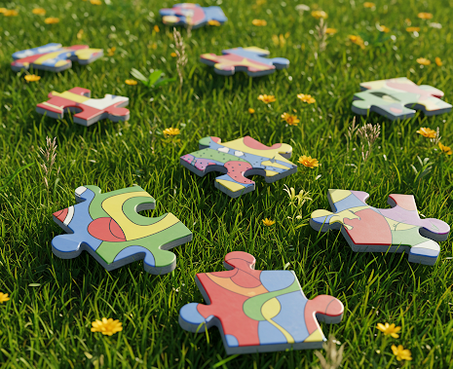
Puzzle-Based Learning
Puzzles and riddles to stimulate problem-solving.
Targets cognitive challenges.
Builds towards a final goal.
Notes:
Puzzle-based learning uses challenges and riddles to stimulate logical reasoning and problem-solving. It’s not just about games—it’s about embedding cognitive struggle into the learning process in a meaningful way.
Escape room learning adds narrative and progression. Students solve puzzles to “escape,” and each challenge builds towards a final goal. This layered problem-solving promotes engagement and a wider view of the taught topics.

Slide 4

My Experiment for ???? Module
Embedding these mechanics in the different teaching material.
MCQs, riddles, adjusted lab exercises etc.
Icons hinting where the clues are.
Some false leads.
Span 10 weeks, (a)synchronous.
Clues “unlock” letters.
Arrange them to spell a key concept.
Notes:
I used this in a one of my modules. I embedded riddles and clues across the teaching material. Some MCQs revealed letters, labs required tweaking parameters, and a few tasks had subtle logic puzzles. Icons like puzzle pieces, locks, and keys marked real clues—some were red herrings. Over 10 weeks, students collected letters from weekly tasks. In Week 10, they unscrambled them to reveal a key concept and “escape” the module. It wasn’t graded—just an engagement experiment.

Slide 5

(expected) Benefits
Boosts engagement and motivation.
Encourages critical thinking/problem-solving.
Scaffolded challenge (clues build on prior knowledge + acquired)
Mimics real-world challenges (like research, debugging)
Promote collaboration and knowledge exchange.
Notes:
Students often focus on labs and ignore lectures/readings, especially with coursework-heavy assessment. This approach nudged them to engage with all weekly material. It also gave them a chance to practise problem-solving and critical thinking across sources, making learning active and fun. This mirrors real-world, authentic tasks—especially in our field. Today, I’ll guide you through a similar, simplified experience.

Slide 6
Let’s Playearn
You’re trapped in this slide deck! Complete activities to collect clues and use them to escape.
Embedded in the slides are clues. Each one will reveal a letter or more.
Collect them all, unscramble them to reveal the hidden key, and escape!
Notes:
You are trapped in this slide deck and should uncover a hidden phrase to escape!
Clues are embedded in the slides and given material. Each cluse reveals one letter.

Slide 7
The Plan
I will present some foundation concepts relevant to the module.
Your quest is to collected letters/words/concepts, guided by clues, and utilise them to recover the escape key.
The escape key is the name of my module.
Notes:
I will present some foundations concepts that I teach in the module. As you we go through the material and activities, try to figure out the clues and collect the letters.
Your quest is to eventually find the escape key. In this case, this is the name of the module.

Slide 8

The Escape
The escape key is locked inside a chest.
We need two keys to unlock the chest.

Slide 9





Instructions
Have pen and paper (or digital alternative) ready
Look things up online if needed
Use your preferred search engine or LLM
Take slide screenshots of slides if useful
We’ll use the provided Google Doc
Some slides are timed
Only some activity answers will be revealed
Watch for clue symbols (not all are real 😈)
Related clues share shapes, colours, or styles
Notes:
You might want to have a pen and paper—or a digital equivalent—ready. Feel free to look things up as we go, whether that's using your favourite search engine or even an LLM. You may want to take screenshots of slides, especially if something catches your eye. There's also a shared Google Doc you’ll be using during the session.
Some slides will be timed, and I’ll only reveal answers to selected activities. Watch out for symbols—some indicate real clues, others are just distractions. Clues that go together will be visually linked by matching shapes, colours, or styles. Keep an eye out.
I will share a link to a google document, keep it handy.
—let’s begin.

Slide 10
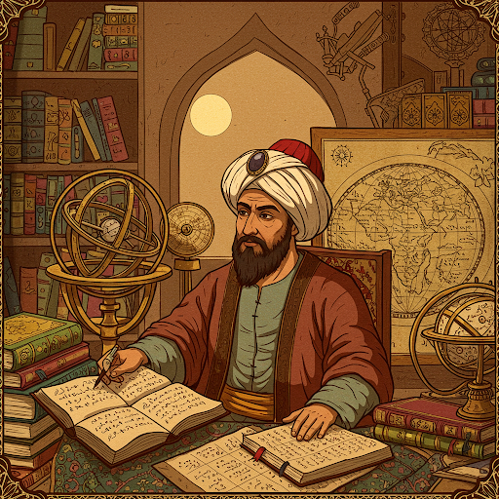
Today’s Topic
Data and Algorithms Shape Our Lives
Algorithms are step-by-step rules to solve problems (like recipes).
After Muhammad ibn Musa al-Khwarizmi.
Algorithms are basically systematic solutions.
Notes:
Today’s topic is how data and algorithms shape our lives. Algorithms are step-by-step rules—like recipes—for solving problems. The term comes from Muḥammad ibn Musa al-Khwarizmi, a Persian scholar whose work in algebra laid foundations for modern computation and the first systematic solution of linear and quadratic equations.
We all interact with algorithms daily—through social media, GPS, shopping, and more.
Algorithms are basically a scientific approach to problem solving.

Slide 11
Activity: Quiz
What determines your Instagram feed?
My Luck
My Facebook feed
My previous Instagram selections
My ex
Notes:
Ideally, I would use polling technology but because of time, I did not want to keep switching between platforms, so for MCQs, you can pop your answer in the chat, and I will use my own judgment to time the activities.
Alright, time for our first puzzle! Here's a multiple-choice question. When you scroll through your ingram feed, you see different new recommendations every now and then. What determines this?

Slide 12
Activity: Answer
What determines your Instagram feed?
My Luck
My Facebook feed
My previous Instagram selections ✓
My ex
Notes:
So yes, the previous selections or history is the main factor here since the algorithm aims to ultimately suggest things that appeal to you or are familiar to you.
Of course, at occasions, there is a bit of randomness to it to keep things alive.

Slide 13

Activity: Quiz
Which of the following is the MOST crucial ingredient for an algorithm to predict effectively?
Relevant and sufficient data
Powerful hardware
Complex algorithms
Skilled programming
Notes:
Here is another one. Think about what we just discussed so far – what do you think is absolutely essential for a algorithm to actually learn something useful?

Slide 14

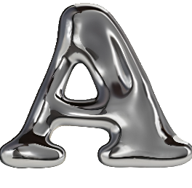
Activity: Answer
Which of the following is the MOST crucial ingredient for an algorithm to predict effectively?
Relevant and sufficient data ✓
Powerful hardware
Complex algorithms
Skilled programming
Notes:
Indeed, relevant and sufficient data. This establishes our first key point - data is the fuel. Without it, even the smartest algorithm is useless.
The letter choice for the correct answer A will be part of our puzzle pieces to be used later and I hope you know why. After that, you are on your own.
Just know if any clues need to be paired to solve a puzzle, they’ll be presented in a way that shows they belong together—through matching colour, style, or other hints.

Slide 15
Data
Data is the most valuable resource
Can come from any domain—medical, legal, gaming, even unicorns 🦄
Every online action creates data
Data drives decisions across sectors
Over 180 zettabytes expected by 2025
🤯
It is mental!
Mental
Mental
🔍
1 Zettabyte = 1,000,000,000,000,000,000 gigabytes: (a trillion gigabytes).
= 250 billion DVDs worth of data…
Notes:
In today's world, data is often called the new oil, or the new currency. It's incredibly valuable! And it comes in all shapes and sizes – words we pictures we take, videos we watch, even the readings from sensors in our phones. It could in any context, medical, legal, from user interactions, or even unicorn data. The sheer amount of data being created every single year is mind-boggling. Just to give you an idea..." (mention statistic) "...That’s mental, mental, mental, that is a lot of data! And all this data needs to be processed and analysed to become useful.

Slide 16
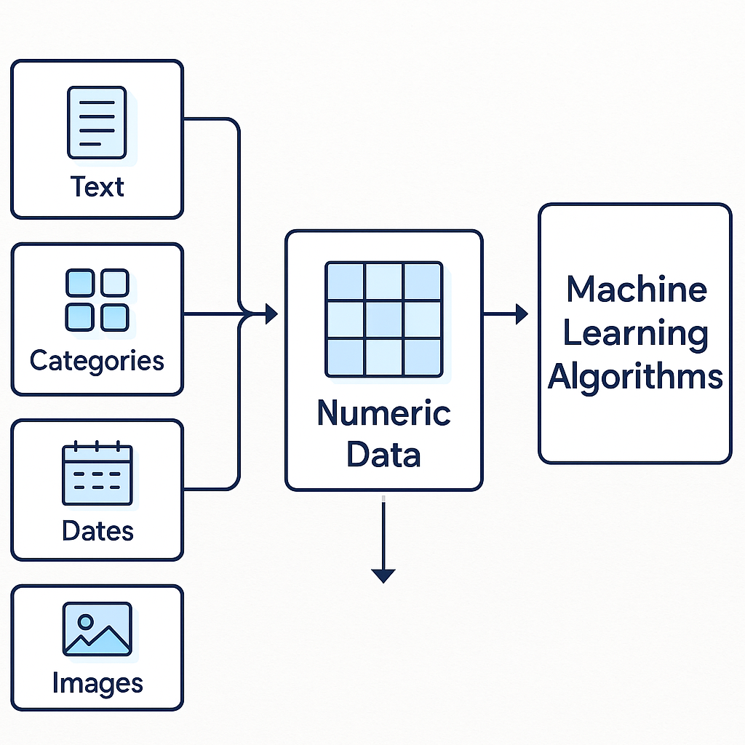
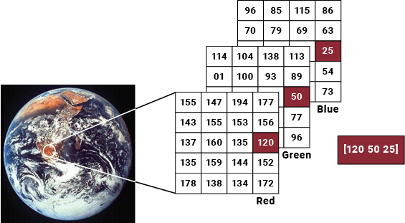
Data and Algorithms
Algorithms require numeric data
Text, images, and sound are converted to numbers
Data exploration helps assess quality
Visualisation is key to spotting patterns and issues early
Notes:
Most algorithms work best with numbers, so we often convert data into numerical form—like turning the label "red" into "1“ or representing an image as matrices of numbers. This transformation can distort reality if not done carefully.
It’s crucial to explore and visualise data before using it. Graphs and charts help spot trends, connections, and potential issues early on

Slide 17
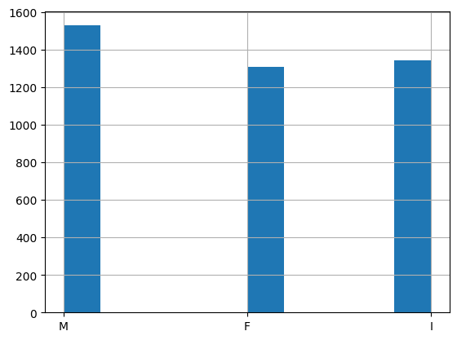
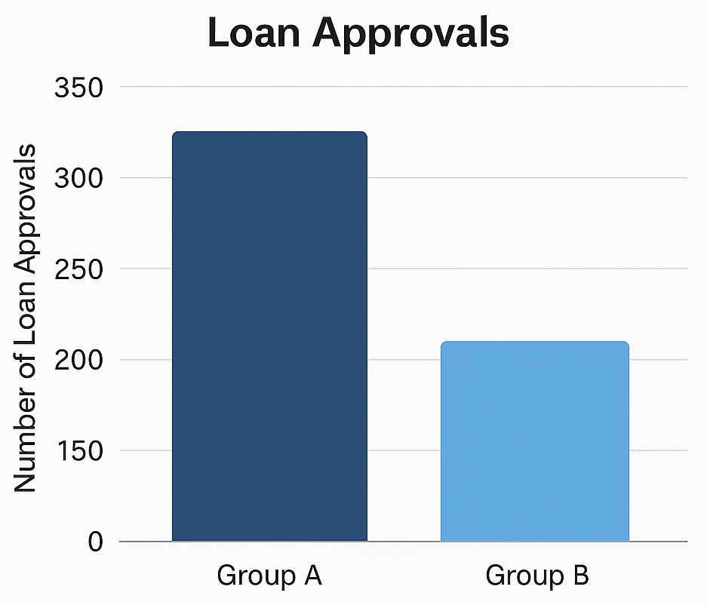
Activity: Observe the distribution
Histogram is useful to spot data imbalance.
Abalone distribution
Count
🔒
Notes:
For example, it is important to work with balanced data for training an algorithm. Here are graphs representing some data. Take a moment to observe it. What do you notice about the distribution of the data between the different groups or categories shown?
On the right side is a simple bar chart of the number of loan approvals for two groups (e.g., Group A and Group B), where Group A has significantly more approvals despite similar application numbers.
On the left side is a histogram of abalone based on sex, there is male, female, and infant and the three classes are not of the same size but close. So, it is a better case that the loan one.
This will give the letter “I” from a later riddle

Slide 18

Activity: Observe the behaviour
In this scrolling scenario, what kind of data could be collected that would be useful for algorithms?
Clicks, Scroll depth, Time on page, Interaction patterns, Engagement rate, Navigation Paths etc.
Notes:
How can such feature be useful? Think of example about those targeted ads you see online. Algorithms need to learn your preferences. Key data includes clicks, page views, search queries, product preferences, device type, location, purchase behaviour, and more. These behavioural and contextual data points train recommendation and personalisation algorithms. However, sensitive information like name, email, and payment details should not be part of the training data.

Slide 19
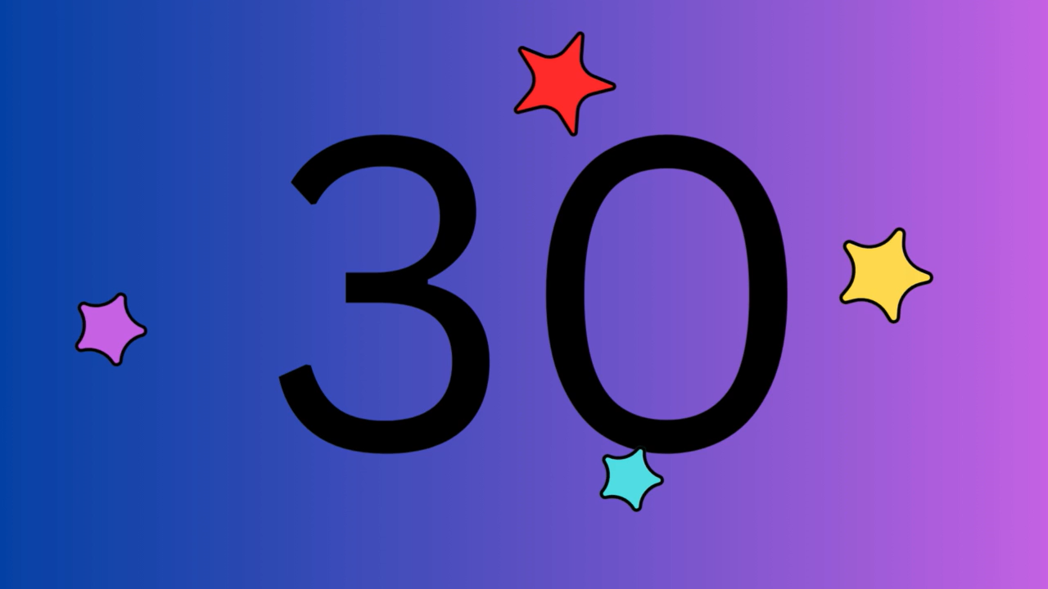
Activity: Observe the behaviour
In this scrolling scenario, what kind of data could be collected that would be useful for algorithms?
Clicks, Scroll depth, Time on page, Interaction patterns, Engagement rate, Navigation Paths etc.
🔒 A histogram of shells, the counts are clear,
The largest and smallest are easy to hear.
One class stands out, the biggest by far,
Another is small, it's barely a star.
Look at the charts, and you will find,
The class that's neither ahead nor behind.
Notes:
Now comes out of no where your first riddle-style piece. I will give you some time t read it and think of what part of the material this is related to or of any other clue you have spotted elsewhere.
If you want a hint, you can find it in your lab sheet in Tab 2.

Slide 20
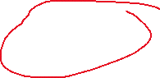

Activity: Observe the behaviour
In this scrolling scenario, what kind of data could be collected that would be useful for algorithms?
Clicks, Scroll depth, Time on page, Interaction patterns, Engagement rate, Navigation Paths etc.
🔒 A histogram of shells, the counts are clear,
The largest and smallest are easy to hear.
One class stands out, the biggest by far,
Another is small, it's barely a star.
Look at the charts, and you will find,
The class that's neither ahead nor behind.

Slide 21

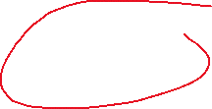

Activity: Observe the distribution
Histogram is useful to spot data imbalance.
Abalone distribution
Count
🔒 A histogram of shells, the counts are clear,
The largest and smallest are easy to hear.
One class stands out, the biggest by far,
Another is small, it's barely a star.
Look at the charts, and you will find,
The class that's neither ahead nor behind.
🔒
Notes:
This will give the letter “I” from a later riddle
Note also the riddle was available in your lab sheet (the google document) which resembles how the students got the clues across different sources. Obviously, I cannot mimic the lab work experiment.

Slide 22
Activity: Analyse the features
It is also important to inspect the data more closely.
And look at the different features.
Go to the labs sheet and check the complete “Analyse the features activity.”
Tab 3.
Notes:
In addition to the data distribution, it is also important to look deeper at the different features or observations and some visualisations structures are useful for that.

Slide 23
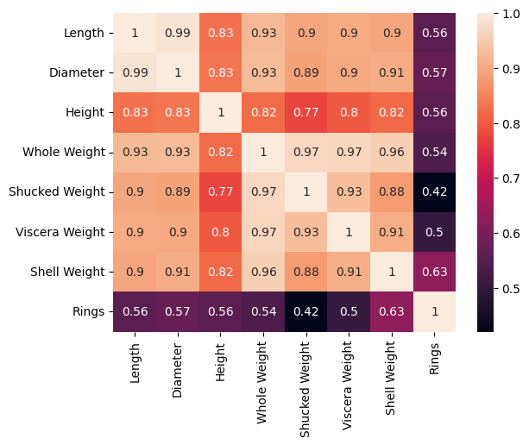
Activity: Analyse the features
Heat map for the abalone data.
Warmer colour = higher correlation.
Useful in feature selection.
In a wave of flames, where colours run,
Where 7 and 8 are less than 1.
Look for a shape that stands wide,
It helps you “cross” to the other side.
What letter hides in this fiery sea?
The answer lies in what you see.
Notes:
This next visualisation is a correlation matrix of the abalone dataset.
The abalone observations are described with features like the length, diameters, height, number of rings and so on. A correlation matric shows how different features in a dataset relate to each other. A strong colour or number indicates a strong relationship, while something closer to zero or a lighter colour suggests a weaker connection. When features in your data are highly related, it's like having multiple ingredients in a recipe that do the exact same thing – it confuses the algorithm trying to learn what's important. On the other hand, if each feature is quite different, the algorithm can clearly see how each one contributes to the final prediction, making the learning process more reliable.
Take a look – are there any features that seem to have little to no relationship? What about features that have strong correlation? The way those relationships are represented might just reveal our next letter.
This will give the letter “T”
In a wave of flames, where colours run,
Where 7 and 8 are less than 1.
Look for a shape that stands wide,
It helps you “cross” to the other side.
What letter hides in this fiery sea?
The answer lies in what you see.

Slide 24

Activity: Analyse the features
Heat map for the abalone data.
Warmer colour = higher correlation.
Useful in feature selection.
In a wave of flames, where colours run,
Where 7 and 8 are less than 1.
Look for a shape that stands wide,
It helps you “cross” to the other side.
What letter hides in this fiery sea?
The answer lies in what you see.

Slide 25
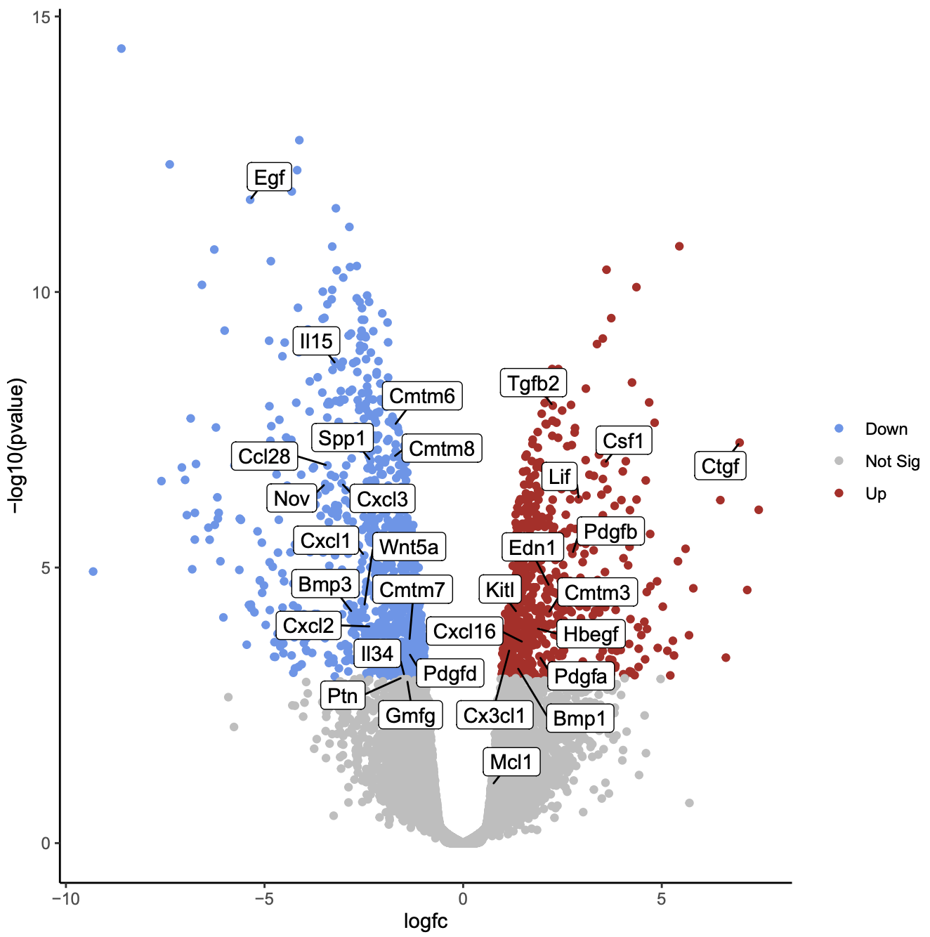
What do algorithms do?
Find patterns in data
Find consistency
Find inconsistency
This Photo by Unknown Author is licensed under CC BY
Notes:
So collectively, algorithms are essentially pattern detectors—they sift through data to uncover regularities, spot consistencies, and just as crucially, flag anything that doesn’t fit. Whether it’s predicting trends or identifying anomalies, they work by learning from what’s typical and noticing when something breaks the mould.

Slide 26


Spot the capital differences in Ms Blue 🔐
Notes:
Just like in a "spot the difference" puzzle. Have a quick look at these two images. Can you spot four differences between the lady Blue and her realistic hallucination?
You could write down the names of objects you spotted.
If the pictures are too small from the slideshow, they are available in your lab sheet in Tab 4.

Slide 27
Spot the capital differences in Ms Blue 🔐
Hat
Earring
Necklace
bag
Ice-cream
Notes:
Now, this is a great way to think about what algorithms do. They first recognise the overall pattern—the shared scene, like the coastal setting. But to make meaningful decisions, they also need to pick up on subtle differences, just like you did with the characters

Slide 28
What algorithms really do
Find patters + make decision = prediction
Regression: predicting a continuous value (a number).
house prices based on size and location.
CO2 emissions based on traffic and temperature
Classification: Predicting which category something belongs to.
Face recognition
Fraud detection
Notes:
So, what do all these algorithms actually do? In many cases, it boils down to making predictions. There are different types of predictions. One type is called regression, where we're trying to predict a number – like how much a house will cost or what CO2 emission or the temperature will be. Another type is classification, where we're trying to put things into categories – like recognizing a face in a photo or identifying if an email is spam. Both regression and classification rely on the patterns the algorithm has learned from the data.

Slide 29
Activity: Quiz
Imagine you want to teach an algorithm to identify different types of fruit. What would be the BEST way to provide the "learning material" (data) to this algorithm?
Give it a list of fruit names in alphabetical order
Show it many pictures of different fruits, labelled with their names
Describe the taste of each fruit using abstract words
Provide it with the chemical composition of each fruit
Notes:
Next question! Let's say we're teaching a computer to recognise different kinds of fruit. What would be the BEST way to provide the "learning material" (data) to this algorithm? How would you best show it what a banana looks like versus an apple, so it can learn to tell them apart?"

Slide 30

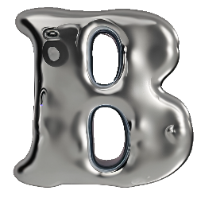
Activity: Answer
Imagine you want to teach an algorithm to identify different types of fruit. What would be the BEST way to provide the "learning material" (data) to this algorithm?
Give it a list of fruit names in alphabetical order
Show it many pictures of different fruits, labelled with their names ✓
Describe the taste of each fruit using abstract words
Provide it with the chemical composition of each fruit
Notes:
The answer is B, feed the algorithm fruits as pictures alongside the name of each, such that when it is presented with a new picture of a fruit, it is able to spit out its name.

Slide 31
Activity: Arrange, orderING is 🗝️
If you are to train a virtual pet, what would be the steps?
Complete the ordering in your lab sheet Tab 5.
Experiment with rewards
Adjust rules based on outcomes
Label its behaviors (Good/Bad)
Notice improvements over time
Repeat the process

Slide 32
Activity: Answer… orderING is 🗝️
Reinforcement learning.
Label its behaviors (Good/Bad)
Repeat the process
Experiment with rewards
Notice improvements over time
Adjust rules based on outcomes
Notes:
So the steps are pretty much as if we are training a real pet. We want to specify which behaviour is good and which is bad, use a reward system positive and negative like treats or no treat etc. and of course every pet is different so the rules are not fixed and must be adaptive, hence the process is iterative, and we monitor progress and outcome to adjust over time.
This aligns with how algorithms are trained to perform a task or make a decision. This is called reinforcement learning. And the ordering of these steps is key to the quality of outcome.
Gives the puzzle pieces “learn+ing”

Slide 33
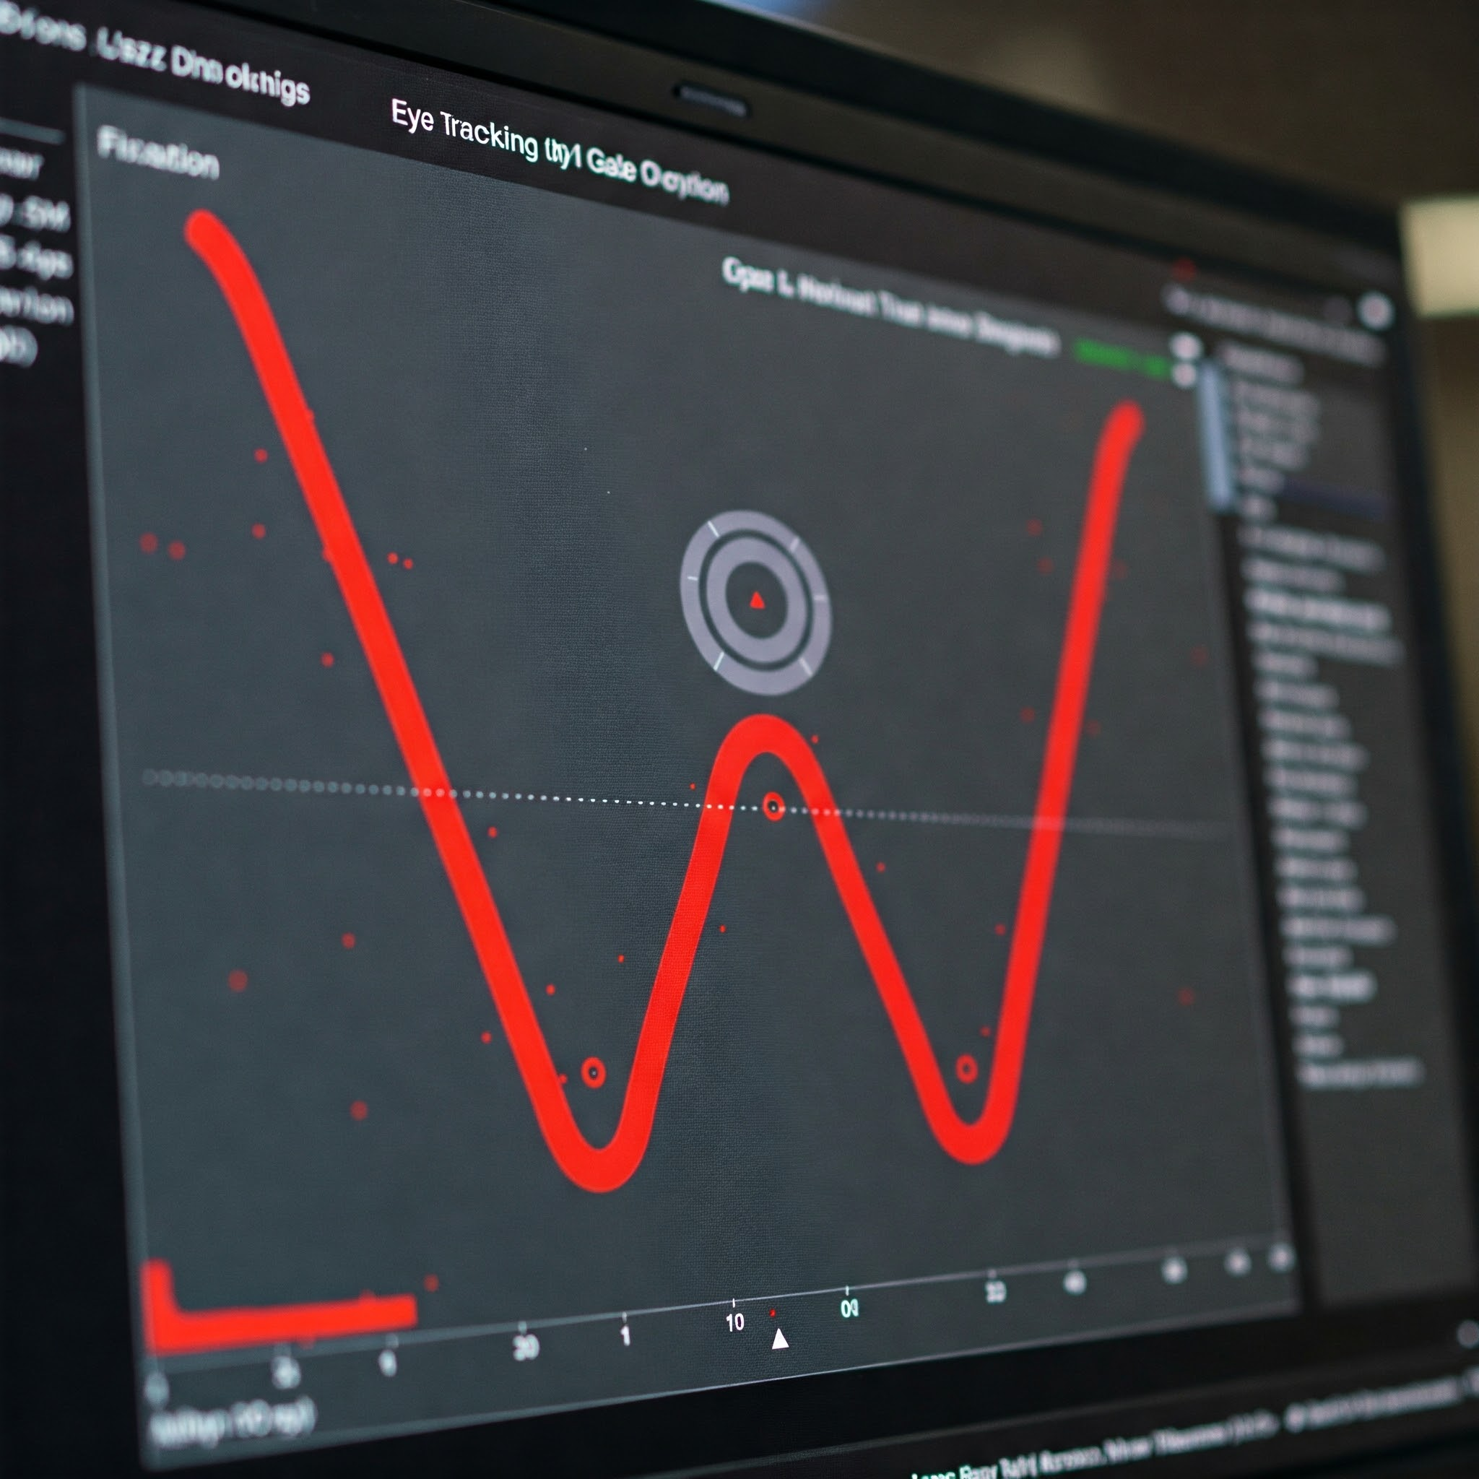

User data is very useful for algorithms
Interesting data could be collected from mouse activity and gaze.
Advertisement or common products are to be placed at or near these locations.
Notes:
One of the things that could be analysed in the mouse movement or the gaze on the screen. Here is an example of eye tracking data to gauge where are users likely to look while using a website.
Advertisement or common products are to be placed at or near these locations.
The clues leads back to the heat map.

Slide 34
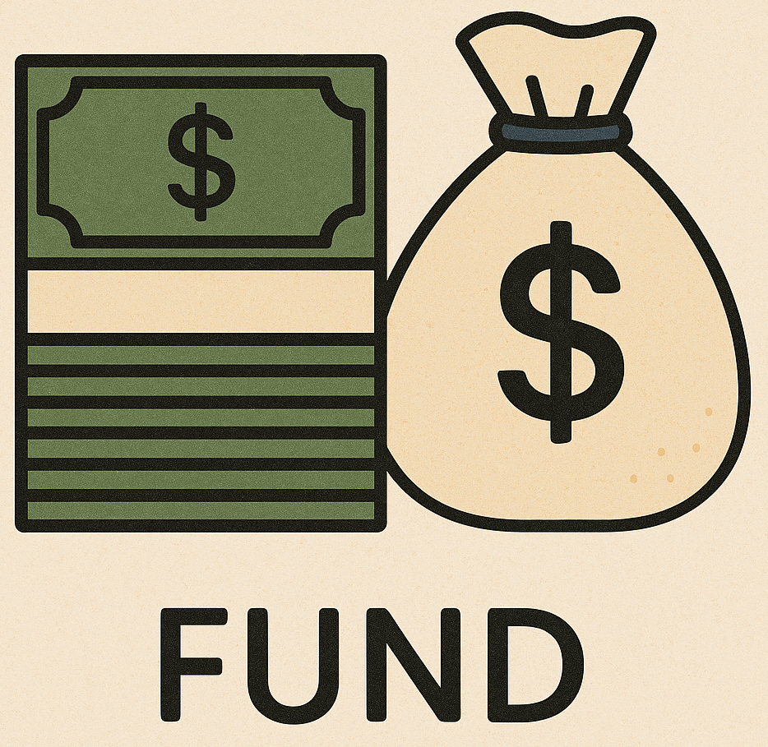

But data collection is expensive
The biggest barrier
High-quality data is essential.
🧩
We always need
Notes:
So we established that algorithms work with data, and the better the data, the better the output of the algorithm. However, data collection is costly, especially in real-world scenarios where setup, access, or annotation adds complexity. Funding is a key barrier, and poor-quality data can lead to weak models. As educators, researchers, or data analysts in any discipline, we always need funding.

Slide 35
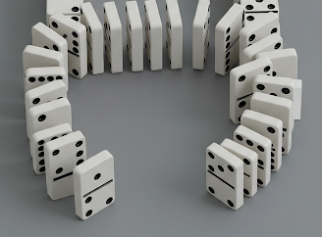
What if
But what if your history is limited
The abalones are extinct
The sensor is faulty
Data is scarce or difficult to collect
The participant provided inaccurate responses
Bad data = bad predictions
"Garbage in, garbage out“
Like a dominos effect.
🔓
Notes:
Add to that, real world data is often messy and imperfect, with missing or incomplete information. Algorithms rely on this data, but limited or erroneous data can lead to inaccurate outcomes. Garbage in garbage out. Like a dominos effect.
One key issue is unbalanced data, where some groups are overrepresented, leading to inaccurate predictions and unreliable systems. Like a dominos effect, the bad effect starts from the data all the way to the outcome of the algorithm.

Slide 36
Activity: Quiz
An AI hiring tool preferring male candidates over equally qualified females. What can introduce such outcome?
1) Unbalanced data
2) Programmer assumptions
3) Historical inequalities
4) Insufficient data
5) All of the above
Notes:
We have this situation where An AI hiring tool preferring male candidates over equally qualified females. What can introduce such outcome?

Slide 37
Activity: Answer
An AI hiring tool preferring male candidates over equally qualified females. What can introduce such outcome?
1) Unbalanced data
2) Programmer assumptions
3) Historical inequalities
4) Insufficient data
5) All of the above ✓
Notes:
Indeed. This behaviour and outcomes have many sources, which could occur compound or individual at different stage of the process.
What letter can we extract from this slide?

Slide 38

Activity: Answer
An AI hiring tool preferring male candidates over equally qualified females. What can introduce such outcome?
1) Unbalanced data
2) Programmer assumptions
3) Historical inequalities
4) Insufficient data
5) All of the above ✓
Notes:
The number five resembles the letter s

Slide 39
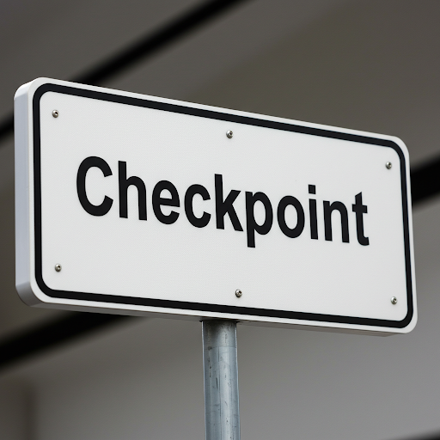

What do we have so far?
E, H, N, I, b, M, C
Notes:
Now let us do a rundown of our inventory. If you have collected these letters, you are amazing!
If you missed some, that is alright. If you have more, you are just taking this too seriously…
The large silver letters are collected from the quizzes
Spot the difference gave us: Earring, Hat, Necklace, Ice-cream, bag
The dominos effect gave us the C
The eye tracking picture gave us the M

Slide 40
Activity: Appraise the Silver Age
Check your lab sheet and complete the Appraise activity.
Tab 6.
Use the answers to reveal the silver key to the first lock.
Notes:
Pop your answers in the chat.

Slide 41
Activity: Appraise the Silver Age
Biased
Flawed
E, H, N, I, M, C
Corrupted
Unaccountable
Discriminatory
Notes:
Right, we have some answers now. Given the theme of the answers to the appraisal activity things around biased, discriminatory, exclusionary, etc.
And given the large letters that were highlighted to you as answers to some of the activities,

Slide 42
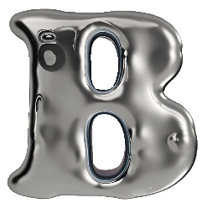



What puzzle pieces make sense so far?
E, H, N, I, M, C
Notes:
We can conclude the first concept as bias. We will extract these letters from the list we have.
What about the T?

Slide 43
One seal broken!
Algorithm Bias
🔓
Notes:
Algorithm bias is a crucial concept in this field, and one of the topic taught in my mystery module.

Slide 44
Unlock the other!
-.. .- - .- / ... -.- . .--
The second key is the source of the first.
It is data trait that causes algorithm bias.
Send a telegram to Ms Blue. She will help you with the second lock.
Notes:
Now let us try to break the second lock. The key to the second lock is that it is the source of the first (which was bias), they go hand in hand.
See if you can figure out this concept. This is your last task in the lab sheet. Task 7.

Slide 45

Unlock the other!
-.. .- - .- / ... -.- . .--
The second lock is the source of the first.
It is data trait that causes algorithm bias.
I twist the truth, just out of view,
I pull the data, warp it too. 🔐
It is not quite centred, off to the side,
Asymmetry is something you can't hide.
The balance is off, with all its might,
A lopsided picture, plain in sight.
Four letters I have, rhyming with "view",
Can you guess me? That's your clue.
Notes:
The second key phrase is skew! Algorithms are not neutral—they inherit biases from data or design.

Slide 46

Both seals broken!
Algorithm Bias
Data Skew
🔓
Notes:
Both these concepts are essential components in the mystery module. They are meant to give some indication about the title of the module.

Slide 47
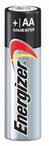
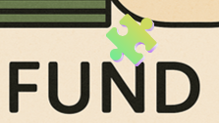
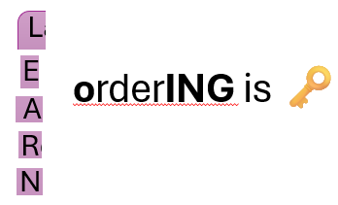
Remaining puzzle pieces
Concepts
Letters/words
Bonus letters:
😏
Algorithm and data
(from the material)
Algorithm bias
(from key 1)
Data skew
(from key 2)
E, H, N, I, M, C
🤯
It is mental!
Mental
Mental
🔍
orderING is 🗝️
Notes:
Now all what is left is look at the remining puzzle pieces that we have not used.
The arrange activity gave us L E A R N and that ordering is key.
We also have three mentals and a fund.
Because we are nearing the end of the ride, I will give you two bonus letters.
You can take some time to look at this or feed the pieces to a DeepSeek as it was the only LLM model able to reason about this.
I will also give you a double A barratry for bonus letters.

Slide 48
So?
M A C H I N E
A mentals
ING
Notes:
If you guessed Machine Learning Fundamentals, this is great, but unfortunately, you are still locked.

Slide 49
Learn to Escape: Boosting Engagement with Riddles
Ready to escape the ordinary? Join this ride and collect clues hidden in plain sight to unlock a secret phrase. It’s part escape room, part 🧠 teaser, all active learning. ✨
Curious? Bring your inner detective and let’s learn!
Clues await… Keep your eyes peeled FOr 🪞 hidden details, not every clue counts. Two letters may be closer than you think..🔍
Notes:
The final annoying piece is given in the welcome tab. If you had a chance to read it carefully, you would have collected the first piece of the puzzle then.

Slide 50
Learn to Escape: Boosting Engagement with Riddles
Ready to escape the ordinary? Join this ride and collect clues hidden in plain sight to unlock a secret phrase. It’s part escape room, part 🧠 teaser, all active learning. ✨
Curious? Bring your inner detective and let’s learn!
Clues await… Keep your eyes peeled FOr 🪞 hidden details, not every clue counts. Two letters may be closer than you think..🔍
FO + mirror = OF
Notes:
This would have given you the mirror or FO which OF

Slide 51


And the escape key is… 🥁
FUNDAMENTALS OF MACHINE LEARNING
Notes:
Finally, our escape key, the name of the module is fundamental of Machine learner. Now you can escape, run out the door and never look back at this hectic presentation ever again…

Slide 52
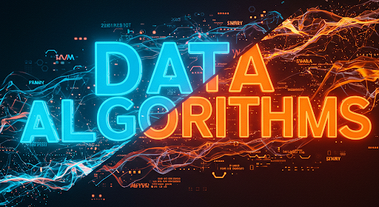
Machine Learning (ML)
A branch of Artificial Intelligence (AI).
It uses algorithms to find patterns and make decisions
Trains on existing data and make decisions on new data.
The more (good) data it sees, the better the outcome.
Machine Learning: algorithms that learn from data.
Notes:
AI and ML are often used interchangeably, but ML is actually a branch of AI—though that’s a topic for another day.
In simple terms, machine learning is about teaching computers to learn from data. Data is the experience; algorithms are the instructions. Unlike traditional programming, ML doesn't need step-by-step rules—just good data. Algorithms learn patterns from existing data to make decisions on new data.
This matters because ML now influences personal areas like social media feeds, credit scores, and even medical diagnoses.

Slide 53
Did it Work?
Feasibility
Effectiveness
Discipline restrictions
Programme-level, across modules
Into the woods (physical world)
❌
✔️
Notes:
Did my learners engage? Not fully—initial excitement faded, and the lack of grading discouraged participation. A cross-module approach might increase excitement, but is it feasible for students?
If there were no limitations, I’d integrate physical activities, like a murder mystery. However, digital tools make it more accessible.
Does the discipline pose barriers? Start small with icons, clues in questions, and tie puzzles to the topic—low-tech, high enthusiasm.
When I run this next time, I will use a different strategy. And I will use more engaging tools. I did not use these digital tools I used today. I merely embedded the activities across the material to encourage the students to explore it. But that does not seem to be intersecting to them.

Slide 54

Thank You
Let us keep rethinking engagement
(and assessments),
one puzzle at a time.
This Photo by Unknown Author is licensed under CC BY-SA-NC
Notes:
Thanks for playing! I hope you enjoyed this ride and perhaps this inspires you to try something similar in your own discipline. Let’s keep rethinking engagement, one puzzle at a time.

